Slide 1

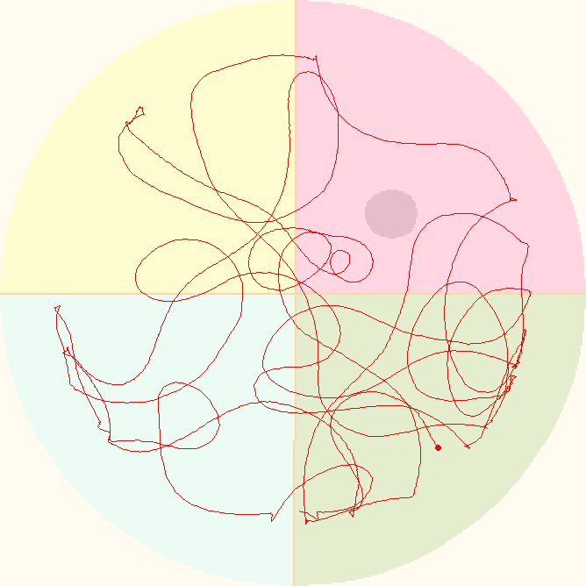
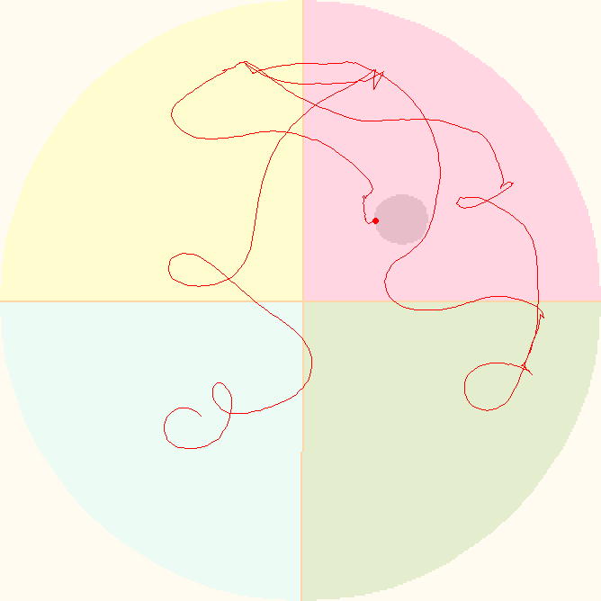
A
Sham
A+S+PBS
A+S+CSL
B
Escape Latency (s)
Day1
Day2
Day3
Day4
B
C
D
Swimming speed (cm/s)
Island crossing
%SA

